Slide 1

SMART CHAIR
Team #10
A. Kishkun
R. Shaniiazov
A. Smerdov
A. Fedoseev
N. Chernyadev
Notes:
Настя

Slide 2


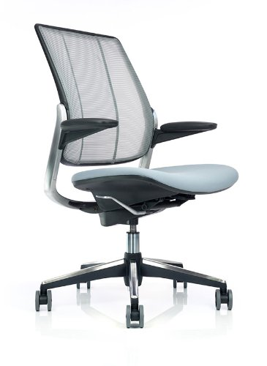
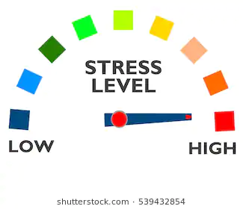
PROJECT IDEA
WHAT?
Realtime stress monitoring
HOW?
Track user movements with sensors installed in the office chair
Process obtained data for indirect prediction of the emotional state

Slide 3
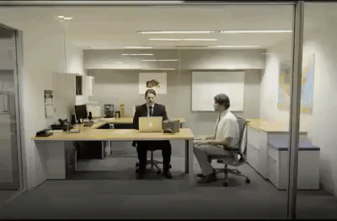
APPLICATION
Smart Chair for Smart Recruitment
Analysis of candidate’s stress resistance
Prediction of possible deviant behaviour
Increased accuracy of psychological portrait
HRM market size worth $30.0 billions by 2025 with CAGR 10.4%
Notes:
Оценить размер рынка для всего
Никита

Slide 4
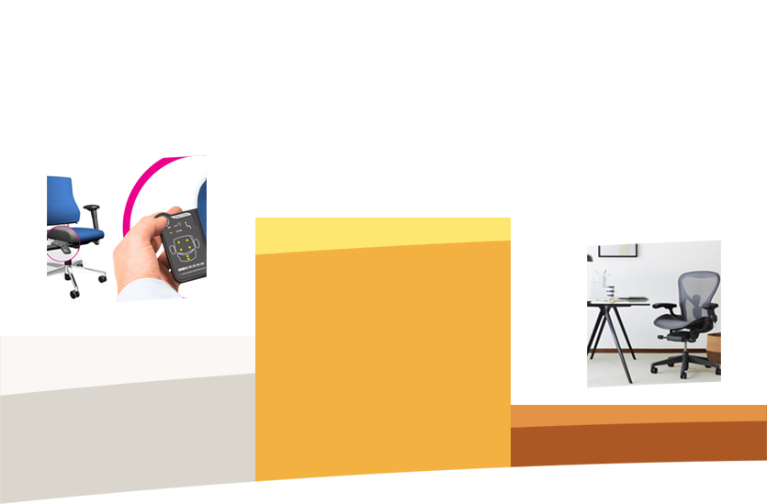
COMPETITORS
Technical:
Posture measurements
Heart rate measurements
No finished product
Non-Technical:
Stress monitoring by heart rate
Stress testing by survey
USP: Indirect continuous stress level monitoring
?
Axia 2.0
Smart Seating System
LiveOS by
Herman Mille
Notes:
TODO: Сделать таблицу
Никита

Slide 5
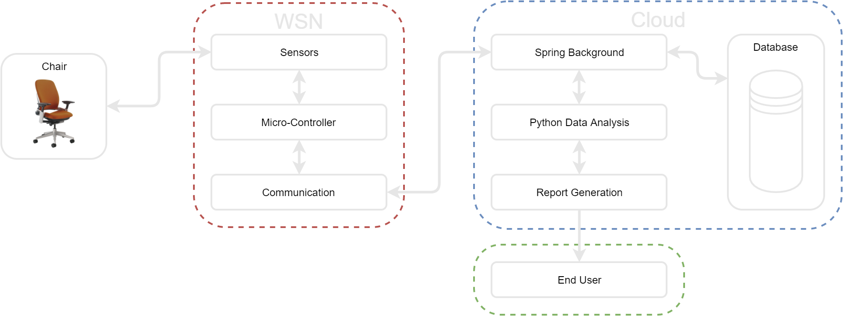
ARCHITECTURE
Notes:
TODO: Общая схема: Ростислав
Леша

Slide 6
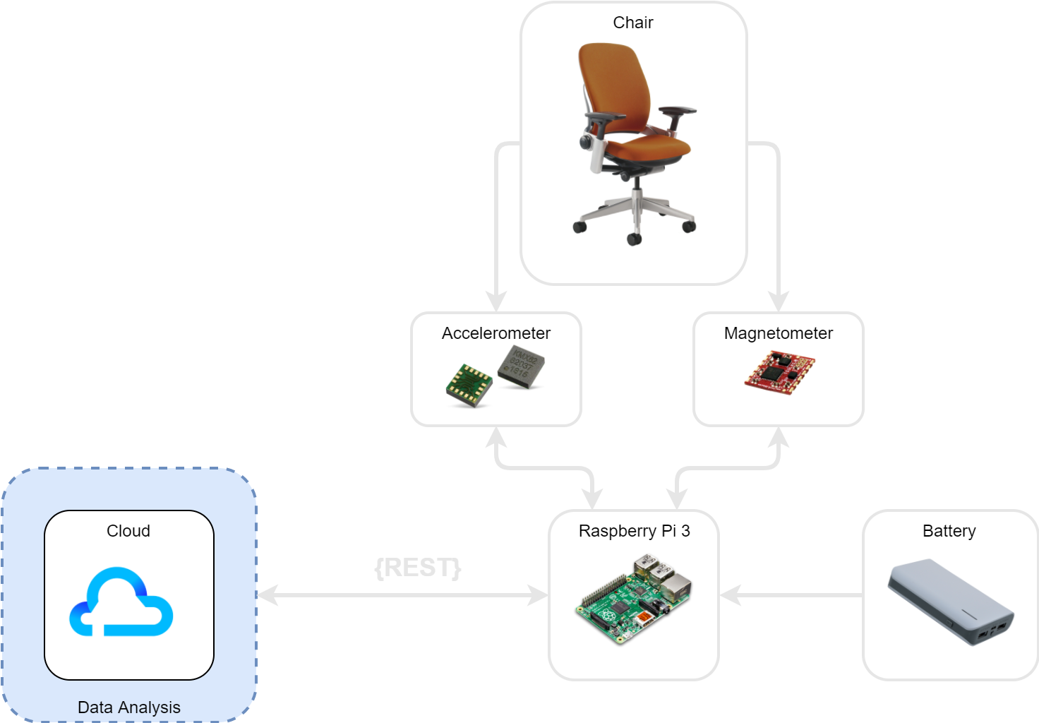
ARCHITECTURE: HARDWARE
Hardware Stack:
Sensing and actuation: accelerometer, magnetometer
Embedded system: Raspberry Pi 3
Power supply: 2.1 A, Li-Po 10000 mAh Battery
Wireless communication: 802.11n WiFi
Notes:
TODO: актуализировать схему, возможно добавить power consumption вычисления
Оценить автономность
Леша

Slide 7


ARCHITECTURE: CLOUD
Software Core: Java with Spring Boot Application
Software Compatibility:
Spring Cloud Native Platforms
Pivotal Cloud Foundry
Hysterix
Amazon Cloud
Data Bases:
MySQL
PostgreSQL
Oracle
MongoDB
Key Features:
Support of deep machine learning and data analysis
Flexible and Scalable Application
Integrated Security
User-Friendly
Notes:
Ростислав

Slide 8
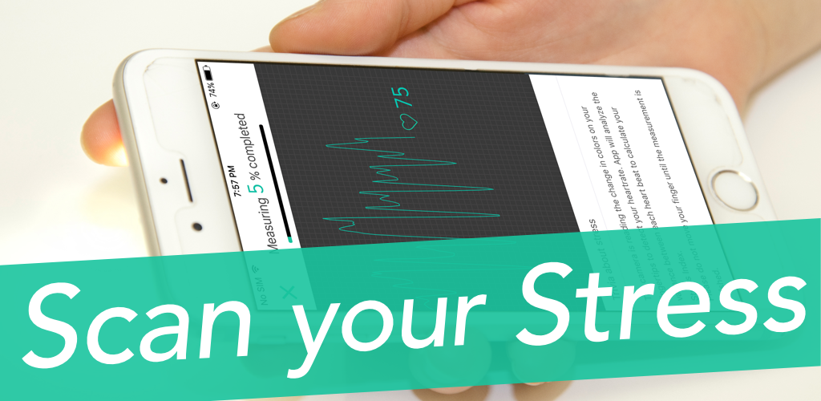
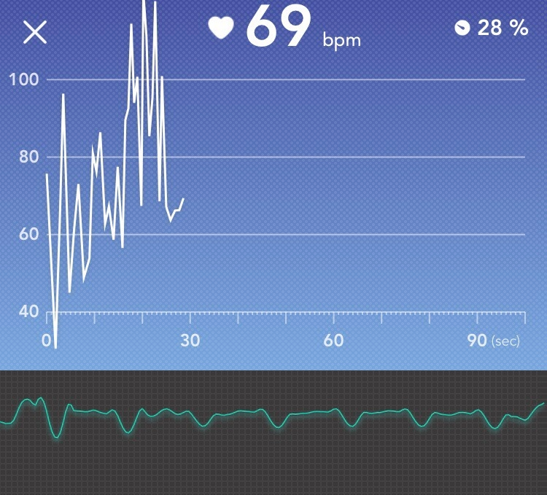
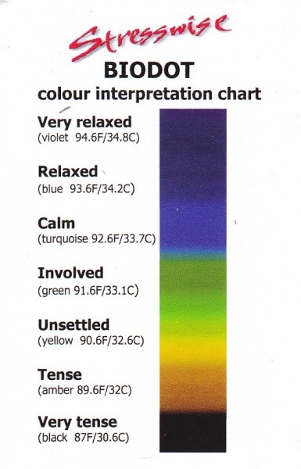
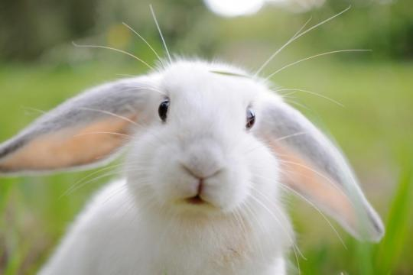
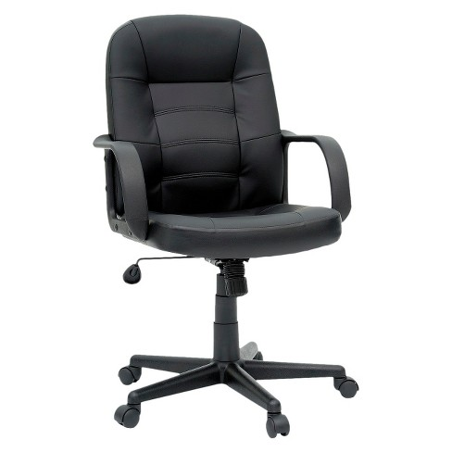
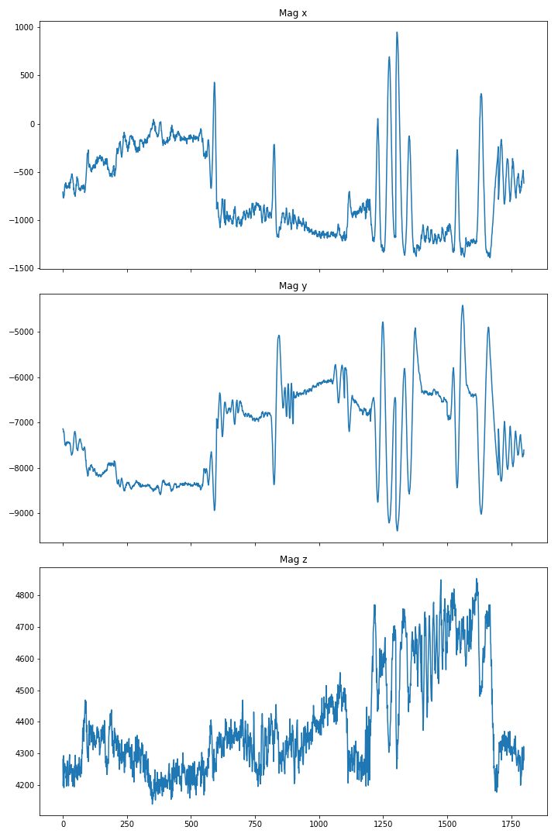
DATA ANALYSIS: DATA GATHERING
Σ
Notes:
Антон графики, схема

Slide 9
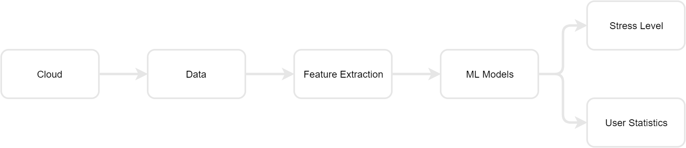
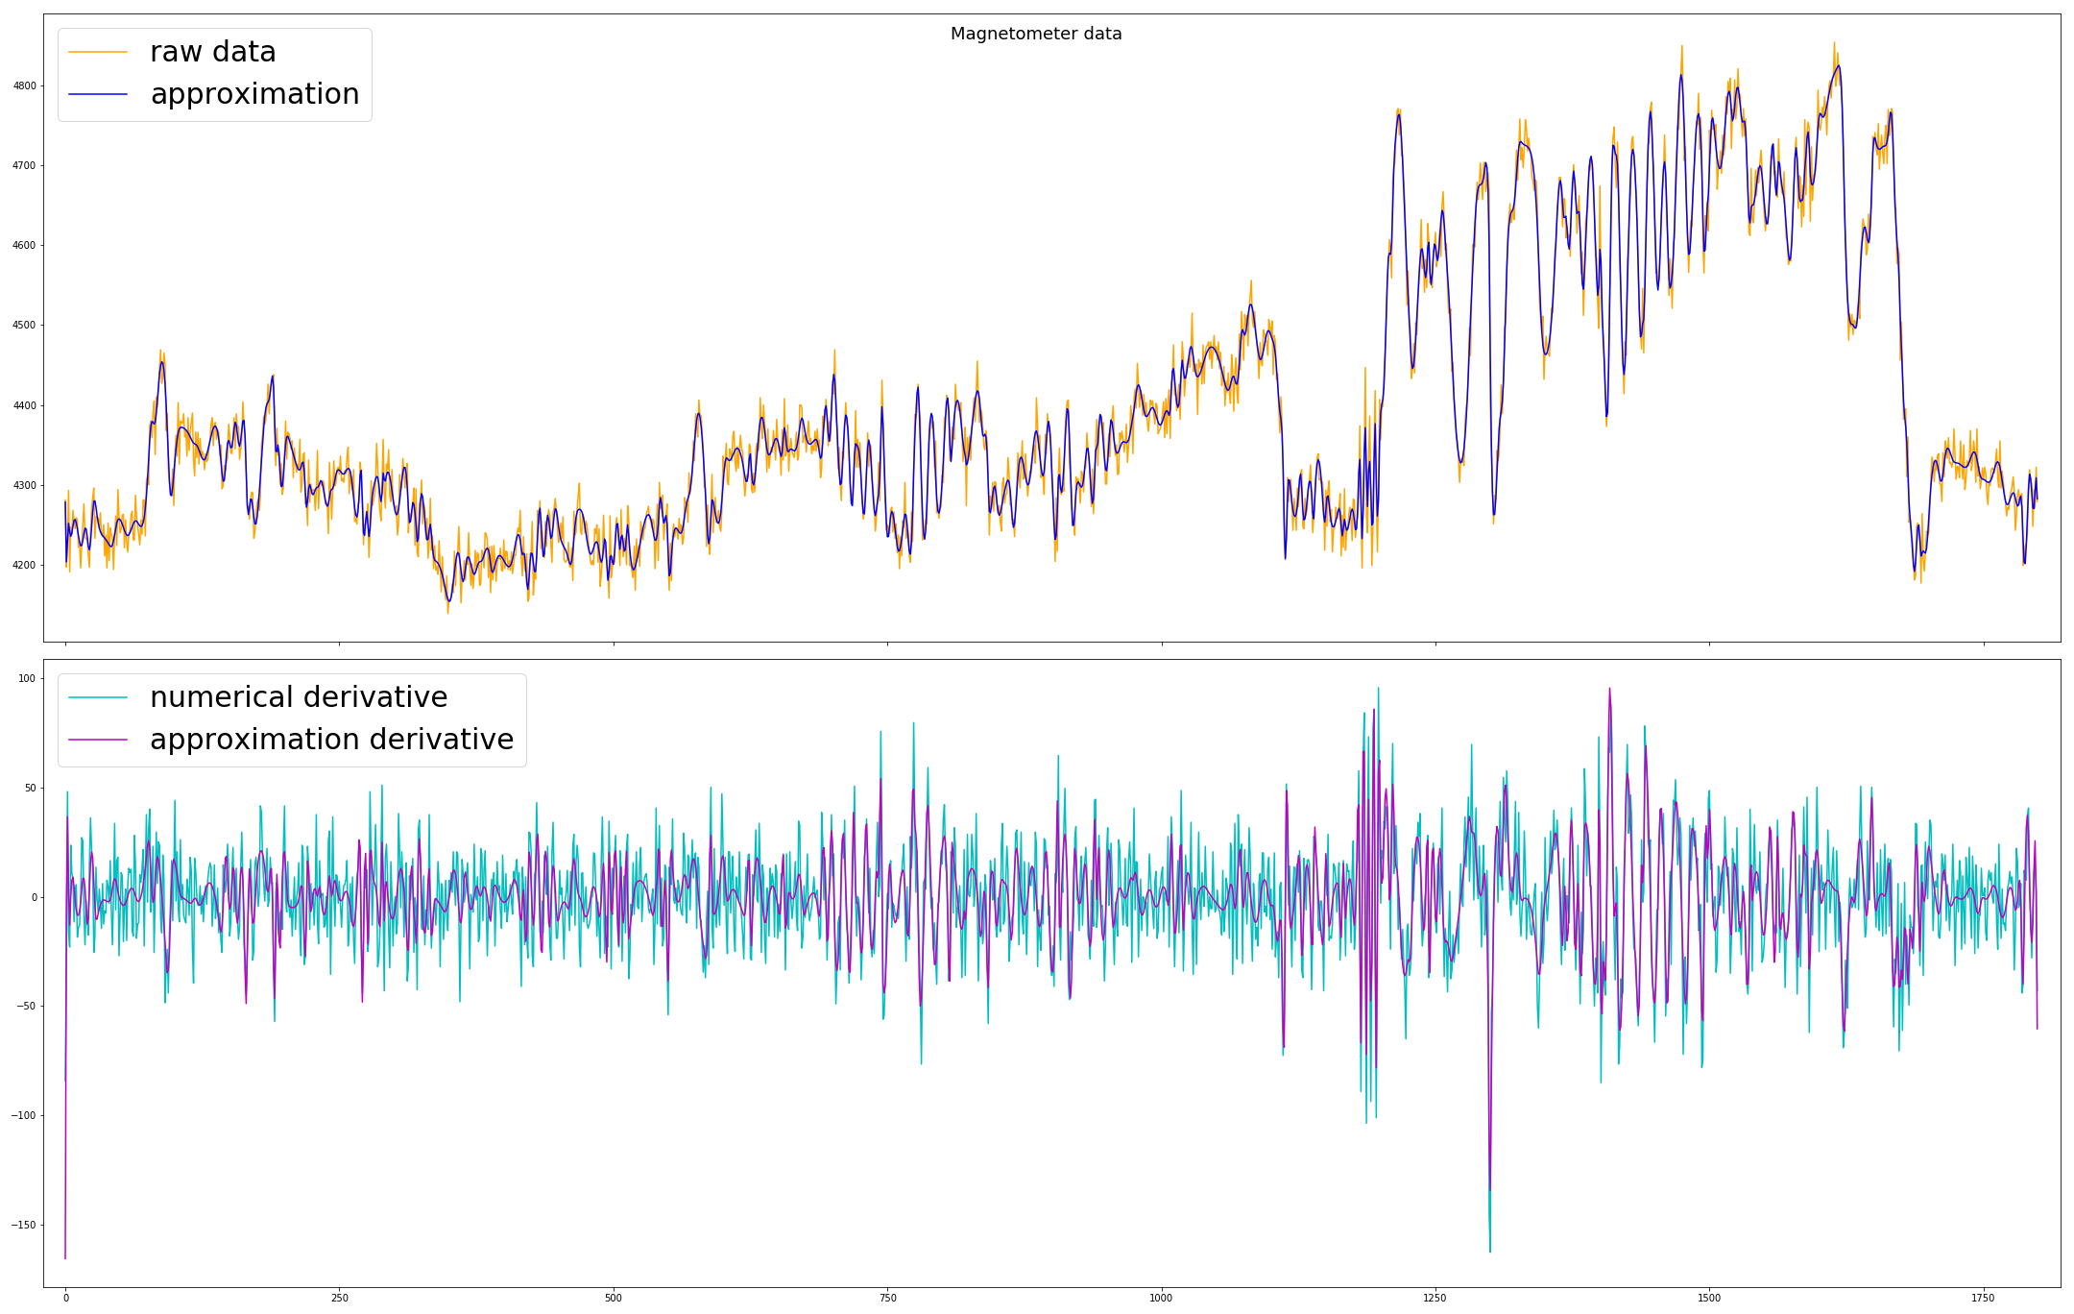
DATA ANALYSIS: PREPROCESSING
6 points from two sensors
Measurements every 0.1 second
Contain noise
Signal is smoothed by splines
Recording 3--5 mins of activity
Approximation with splines
Notes:
Антон графики, схема

Slide 10
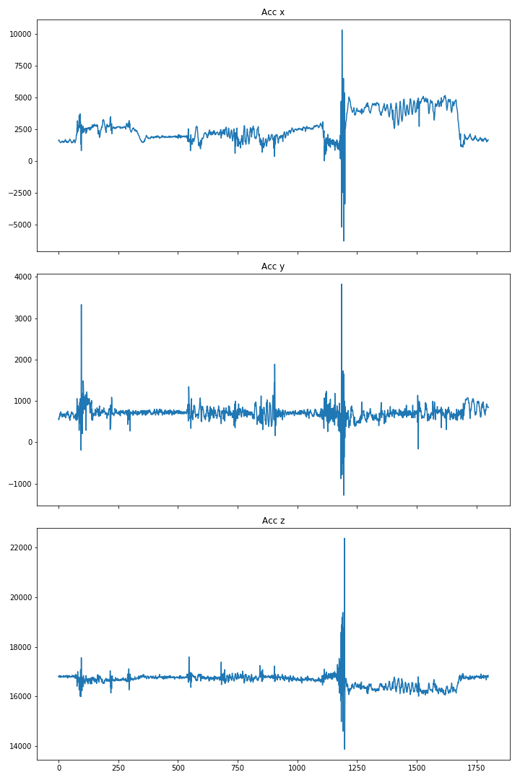
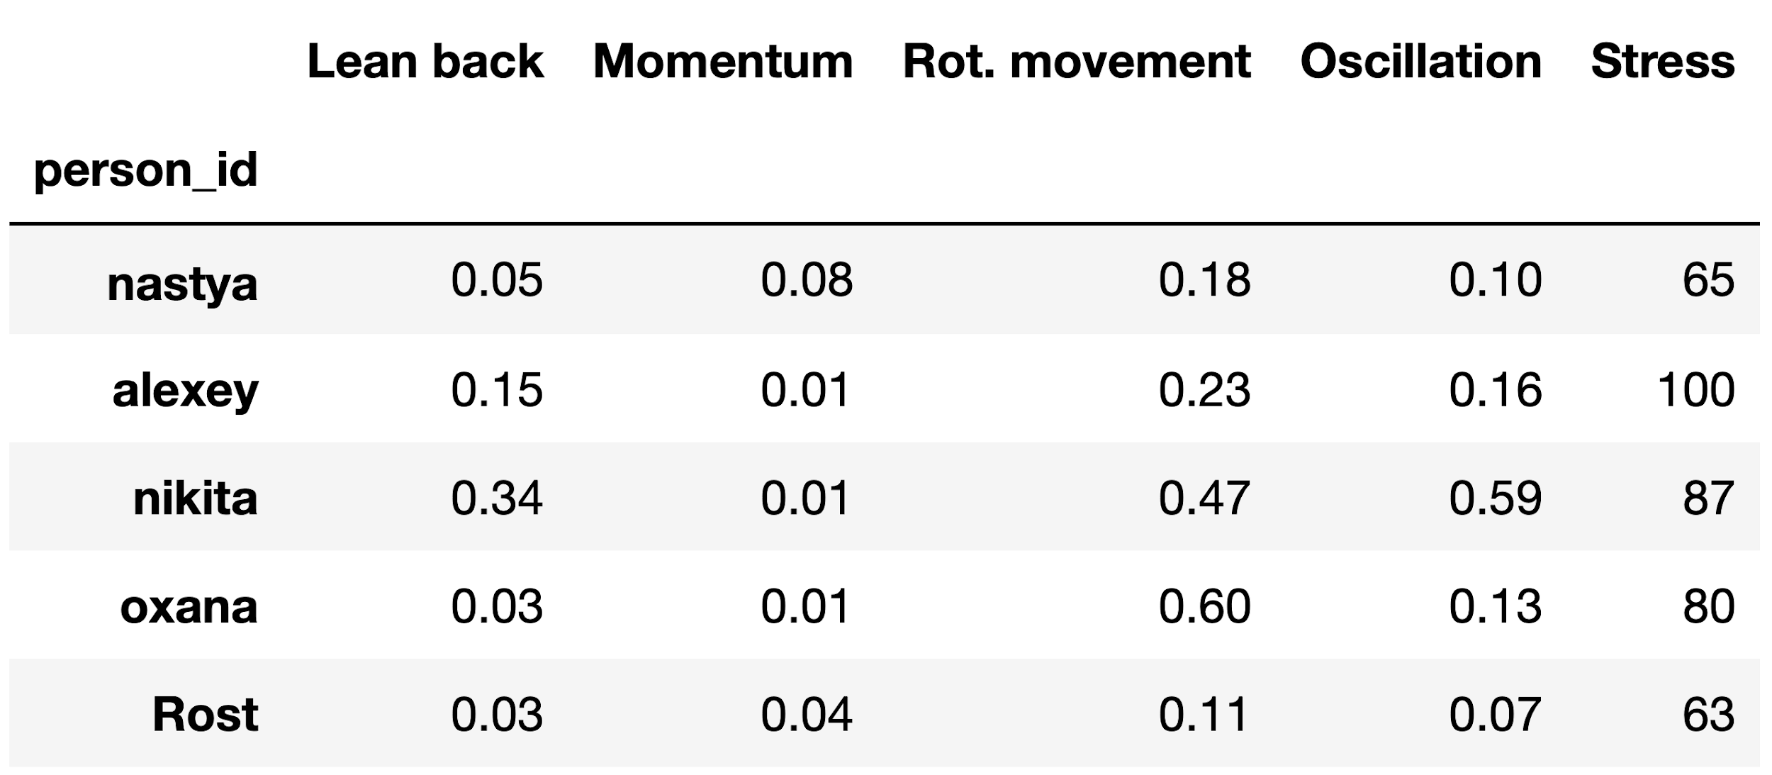
DATA ANALYSIS: FEATURES
Used features:
Lean back time
Translation
Rotation
Oscillations
Provided statistics
Data from sensors

Slide 11
DATA ANALYSIS: FEATURES
Used features:
Lean back time
Translation
Rotation
Oscillations
Provided statistics
Data from sensors

Slide 12
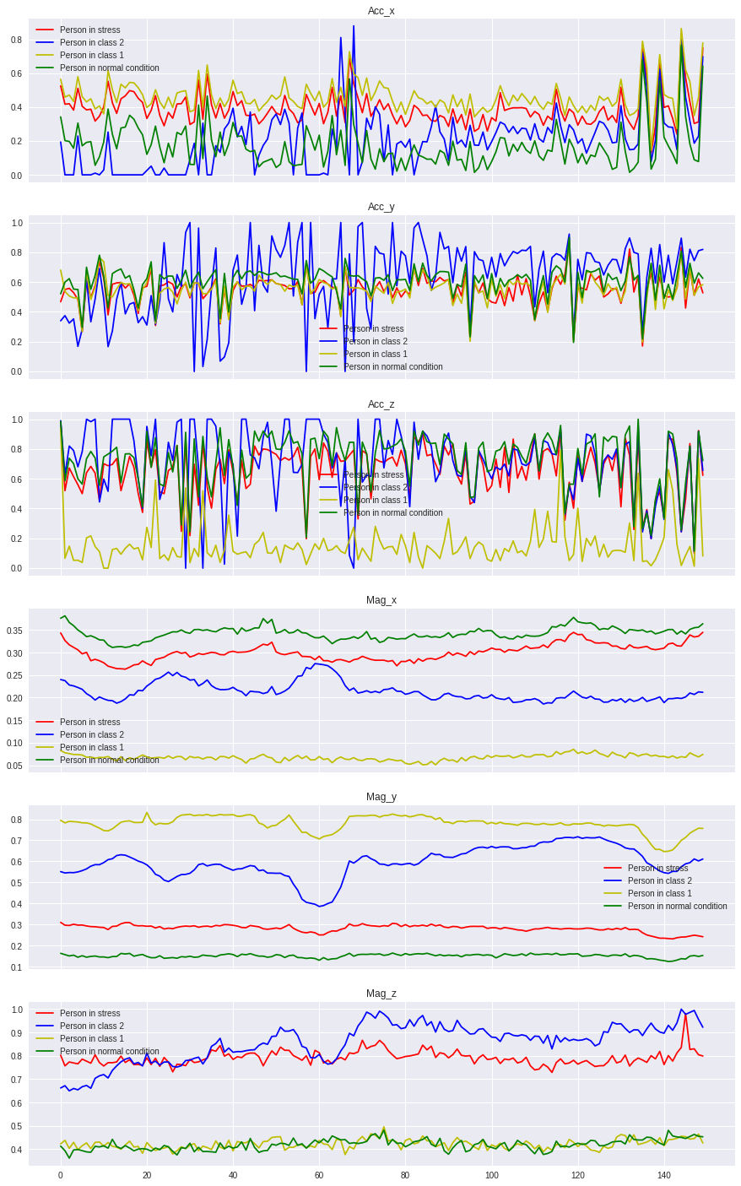
DATA ANALYSIS: TIME SERIES
New feature representation
Problem: 13 valid experiments
Decision:
126 experiments divided by 30 seconds

Slide 13
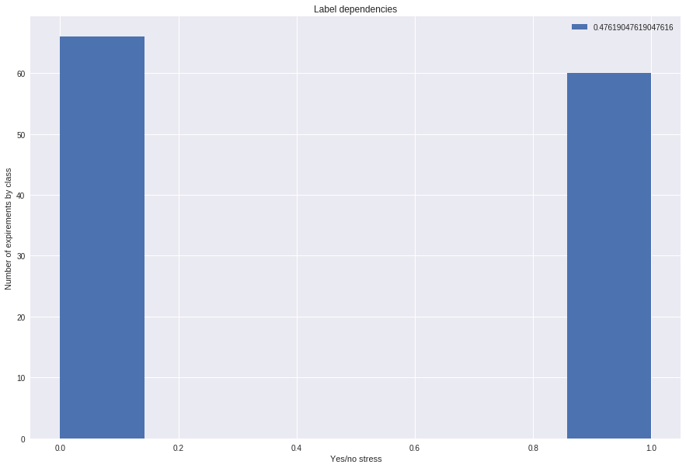
DATA ANALYSIS: TIME SERIES
Binary classification:
Logistic regression
yes/no stress. Level:64
normalized data without new features | KFold score: 0.937 ± 0.074
non normalized data with new features | KFold score: 0.865 ± 0.069
new features only | KFold score: 0.722 ± 0.036
non normalized data without new features | KFold score: 0.865 ± 0.069
normalized data with new features | KFold score: 0.945 ± 0.060

Slide 14
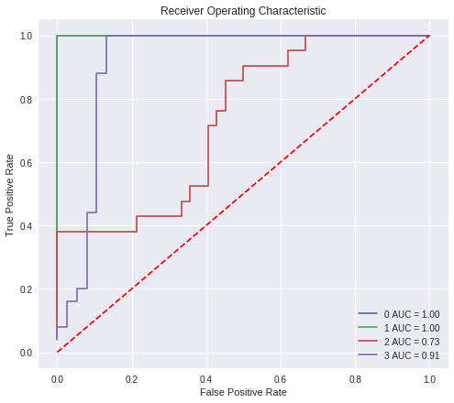
DATA ANALYSIS: TIME SERIES
multilabel classification:
4 stress levels
Grid Search: RandomForest max_features: 9, min_samples_split: 6 Validation: Leave-one-out Metrics: ROC-AUC Accuracy of train is 0.96+-0.001 Accuracy of test is 0.96+-0.17

Slide 15
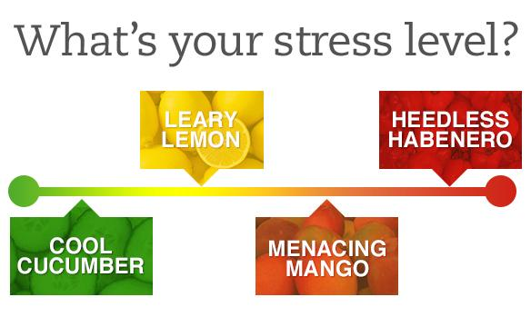
DATA ANALYSIS: TIME SERIES
Future plan
More experiments
More sensors (e.g. gyroscope for perception)
Web-interface for personalized results

